Slide 1
Contoso Chat bot
Andrew Lai
andrewex.lai@hotmail.com
Notes:
Please enter project details and your details here.

Slide 2
About Me! Andrew Lai
I’m studying Computer Systems Engineering 4th year at UoA
In terms of being a developer, I’m interested in automation, IoT and also embedded systems as it has ties with the idea of IoT.
In my spare time, I play the piano (grade 8 ABRSM) and of course playing games!
While working on MSA, I really enjoyed working on this project and experiencing the wonders of web APIs and services like Microsoft Azure services.
In the future, I want to be in a management position in the software dev industry; working with the latest technology.

Slide 3
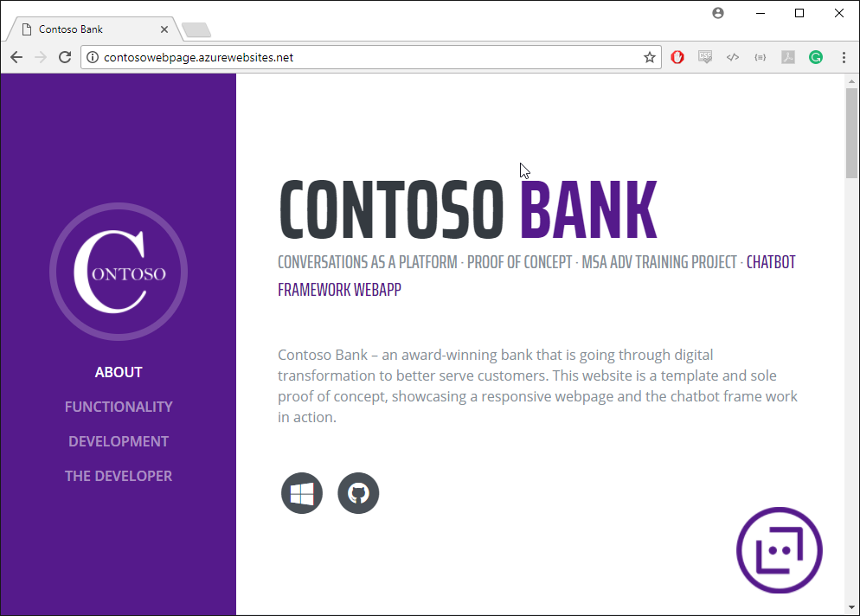
Implementation
Responsive Webpage
Chat bot integrated within Webpage
Notes:
User Experience

Slide 4
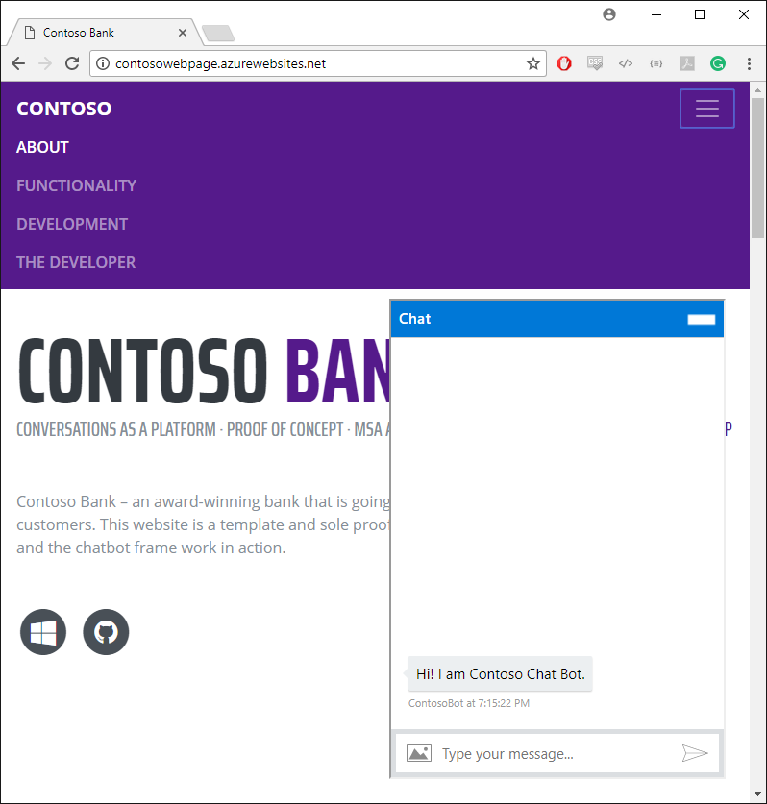
Implementation
Bootstrap framework libraries
Azure deployment through Git
http://contosowebpage.azurewebsites.net/
Notes:
User Experience

Slide 5
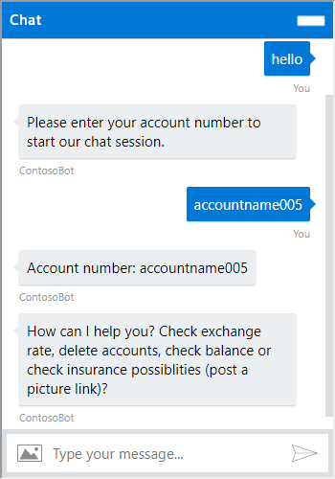
Implementation
Microsoft Bot Framework Chatbot Functionality
Accounts
Easytables db holding account information with dummy data.
Each account listing holds the account name and balance of each account.
User may ask for the selected account’s balance or delete said accounts.
If the account name does not exist, the account entry in the database is created with 0 balance.
Foreign currency balance is held in the database too…
Notes:
User Experience

Slide 6
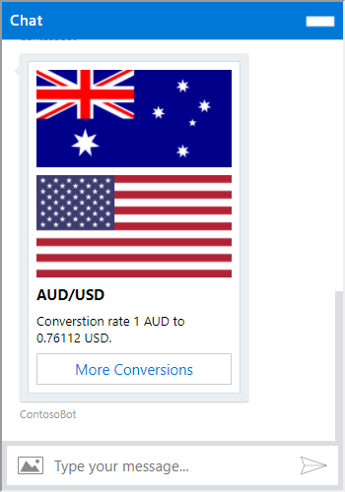
Implementation
Microsoft Bot Framework Chatbot Functionality
Exchange Rate Queries
User may ask exchange rate of various currencies (NZD/curTo or curFrom/curTo).
User may ask which currencies are available to read.
Data is displayed with bot framework cards
Notes:
User Experience

Slide 7
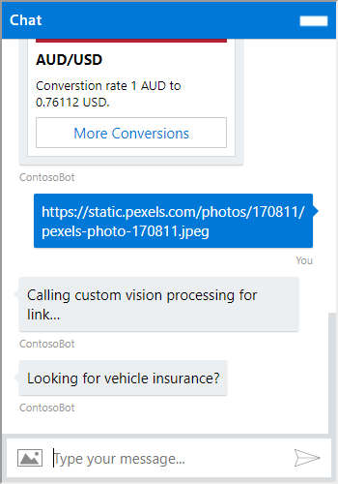
Implementation
Microsoft Bot Framework Chatbot Functionality
Insurance Queries
User may send a link with possible insurance items, reply with a query asking the corresponding insurance type. (vehicle, house, health)
Custom Vision API is used to recognize the image.
Notes:
User Experience

Slide 8
Databases
EASYTABLE – Single Table – /tables/AccountsTable
Name | Type
ID | String
Created, Updated, Version… | Dates Version Boolean
Account | String
Balance | Number
<USD AUD JPY etc.> | Number
Notes:
Talk about your database, what schema you used and what data you used

Slide 9
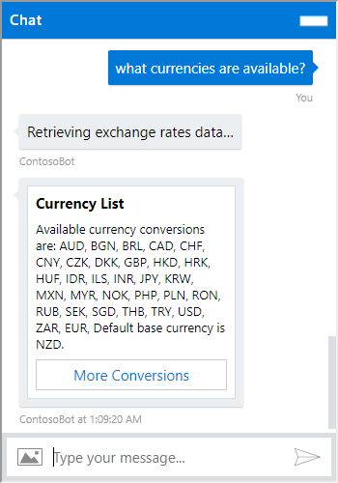
Exchange Rate API
The API used for the exchange rate data is as follows: https://api.fixer.io/latest
The API receives its data from the resource gathered by the European Central Bank which is a limited set number of currencies given.
Flag images are obtained from: http://flags.fmcdn.net/data/flags/w580/
Notes:
Advanced features…

Slide 10
Azure Setup
Chat bot
Azure Webapp
Github integration
Database
Easytables
Webpage
Azure Webapp
Github integration
Notes:
Explain your Azure features here

Slide 11
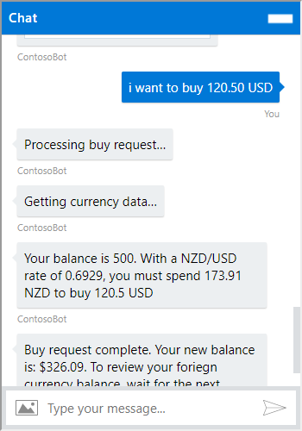
Advanced Features
Foreign Currency Purchases
Users may request to purchase foreign currencies.
A check is done before the account balance has enough currency (NZD) before the purchase can be made. (totalCost = amount/ratio)
Once the purchase can be done, the database entry for the account is updated
Notes:
Advanced features…

Slide 12
Future Possibilities
As each account is accessed without any security measures in mind.
The idea could be allow access to the bot through login access.
A hashed/encrypted key is kept to see which accounts can be accessed.
Further Artificial Intelligence
As the bot deals with currency, why not improve this functionality.
Kalman Filtering for stocks/fx/crypto to obtain smart predictions?
Reinforcement Learning emulation to help good financial decisions?
Notes:
Advanced considerations…

Slide 13
Conclusion
Development of the Bot and the Webpage was a successful project as well as a great learning experience.
http://contosowebpage.azurewebsites.net/
https://github.com/khdrew
Notes:
Any final things you want to tell us

